Slide 1
Data Mining Topic: Decision Trees
Dr. J Angel Arul Jothi
Department of Computer Science

Slide 2
Text Book Chapter 4

Slide 3
Classification
Given a collection of records (training set)
Each record is characterized by a tuple (x, y)
x is the attribute set
y is the class label
Class label is discrete valued (categorical or nominal)
Task:
Learn a classification model that maps each attribute set x into one of the predefined class labels y

Slide 4
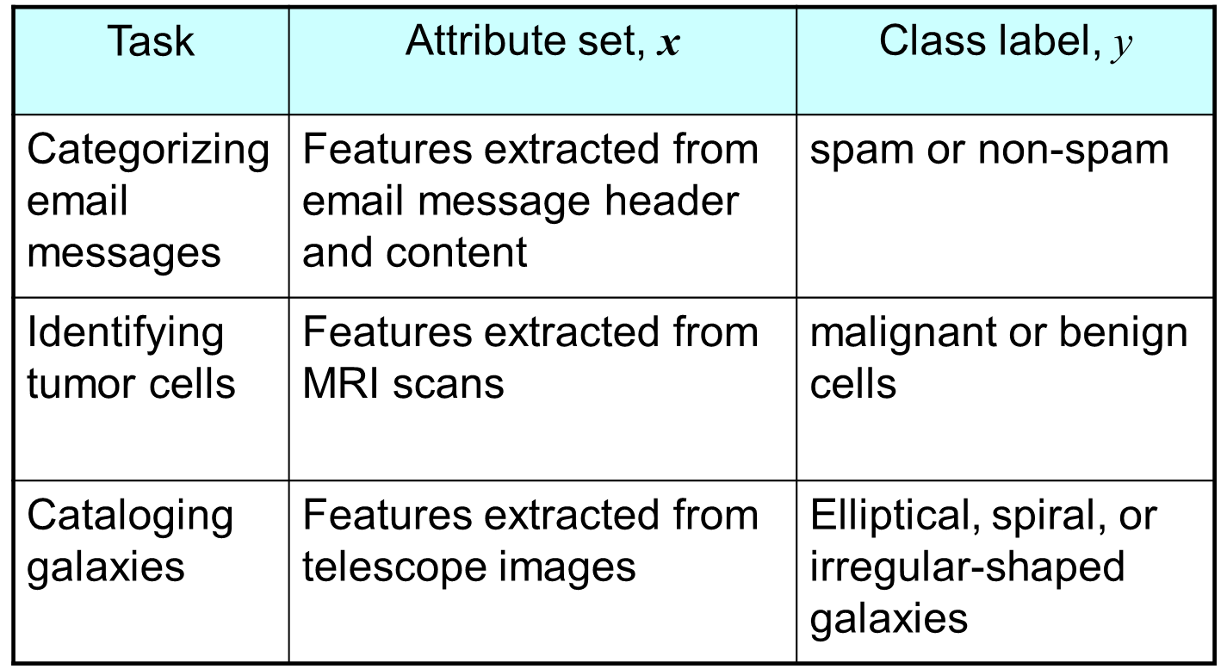
Examples

Slide 5
General Approach for Building Classification Model
A classification technique (or classifier) is a systematic approach to build classification models from an input data set
Examples include decision tree classifiers, rule-based classifiers, neural networks, support vector machines, and naive Bayes classifiers
Each technique employs a learning algorithm to identify a model that best fits the relationship between the attribute set and class label of the input data
The model generated by a learning algorithm should both fit the input data well and correctly predict the class labels of records it has never seen before
Therefore, a key objective of the learning algorithm is to build models with good generalization capability; i.e., models that accurately predict the class labels of previously unknown records

Slide 6
General Approach for Building Classification Model

Slide 7
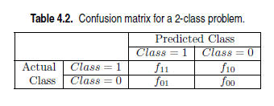
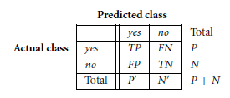

Metrics for Evaluating Classifier Performance

Slide 8
Metrics for Evaluating Classifier Performance
True positives (TP): These refer to the positive tuples that were correctly labeled by the classifier
True negatives (TN): These are the negative tuples that were correctly labeled by the classifier
False positives (FP): These are the negative tuples that were incorrectly labeled as positive
False negatives (FN): These are the positive tuples that were mislabeled as negative
Positive tuples (tuples of the main class of interest ex. Spam/malignant cells) and negative tuples (all other tuples ex. Not spam/benign cells)

Slide 9
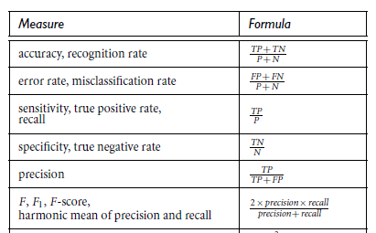
Metrics for Evaluating Classifier Performance

Slide 10
Metrics for Evaluating Classifier Performance
Precision can be thought of as a measure of exactness
what percentage of tuples labeled as positive are actually positive
Recall is a measure of completeness
what percentage of positive tuples are labeled as positive

Slide 11

Metrics for Evaluating Classifier Performance
The following figure shows a confusion matrix for medical data where the class values are yes and no for a class label attribute, cancer. Compute the various classifier evaluation measures.

Slide 12
Metrics for Evaluating Classifier Performance
Answer:
sensitivity = recall = 90 / 300 = 30.00%.
specificity = 9560 / 9700 =98.56%
accuracy is 9650/10,000 = 96.50%
precision = 90/230 = 39.13%

Slide 13
Metrics for Evaluating Classifier Performance
Let actual and predicted denote the actual and predicted class label for a binary classification. Let 1 denote the positive class and 0 denote the negative class.
actual = [1, 1, 0, 1, 0, 0, 1, 0, 0, 0]
predicted = [1, 0, 0, 1, 0, 0, 1, 1, 1, 0]
Compute the classifier evaluation metrics and draw confusion matrix
TP = 3
TN = 4
FP = 2
FN = 1
 | Predicted
Actual | class | 1 | 0
 | 1 | 3 | 1
 | 0 | 2 | 4

Slide 14
Metrics for Evaluating Classifier Performance
Answer:
Accuracy = 7/10 = 0.7
Sensitivity/Recall = 3/4 = 0.75
Specificity = 4/6 = 0.66
Precision = 3/5 = 0.6
F-measure = 2*(0.6 *0.75) / (0.6+0.75) =0.66

Slide 15
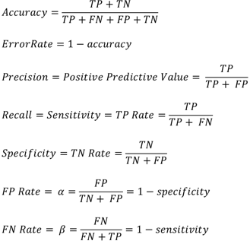
Alternative Metrics
 | PREDICTED CLASS
ACTUAL CLASS |  | + | -
 | + | TP | FN
 | - | FP | TN

Slide 16
Confusion Matrix for multiclass classification
Assume there are 4 classes A, B, C, D.
INTERPRETATION FOR CLASS A
 |  | PREDICTED
ACTUAL |  | A | B | C | D
 | A | TP (A) | FN (A) | FN (A) | FN (A)
 | B | FP (A) | TN | TN | TN
 | C | FP (A) | TN | TN | TN
 | D | FP (A) | TN | TN | TN

Slide 17
Confusion Matrix for multiclass classification
INTERPRETATION FOR CLASS B
 |  | PREDICTED
ACTUAL |  | A | B | C | D
 | A | TN | FP | TN | TN
 | B | FN | TP | FN | FN
 | C | TN | FP | TN | TN
 | D | TN | FP | TN | TN

Slide 18
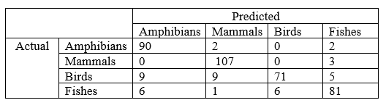
Confusion Matrix for multiclass classification
The table below is the confusion matrix obtained for a classifier for a 4-class classification problem. The four classes are Amphibians, Mammals, Birds and Fishes.
Compute the Specificity for the Mammals class
Compute the F1-score for the Birds class
Compute the FP Rate for the Fishes class
Compute the FN Rate for the Mammals class
Compute the Sensitivity for the Amphibians class
Compute the error rate of the classifier

Slide 19
Confusion Matrix for multiclass classification
ANSWERS
TN = 270, FP = 12, Specificity = 0.95
TP = 71, FN = 23, Precision = 0.92, Recall = 0.75, F1-score = 0.83
FP = 10, TN = 288, FP rate = 0.033
FN = 3, TP = 107, FN Rate = 0.027
TP = 90, FN = 4, Sensitivity = 0.95
No. of correction predictions = 349, Total predictions = 392, Error rate = 0.11

Slide 20
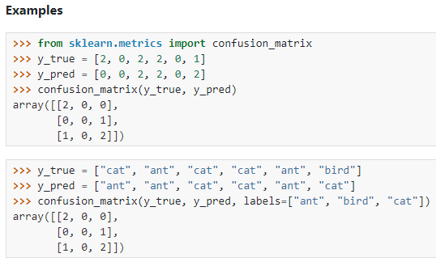
Confusion matrix sklearn
y_true = actual class labels
y_pred = predicted class labels

Slide 21

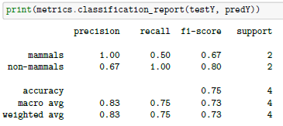
classification_report of sklearn
testY = actual class labels
predY = predicted class labels
P(mammals) = 2, N(non-mammals) =2

Slide 22


Macro average precision & recall
The macro average precision is the arithmetic mean of the precision scores of all classes.
The macro average recall is the arithmetic mean of recall scores of all classes.
The macro average F1 is the arithmetic mean of F1 scores of all classes.

Slide 23
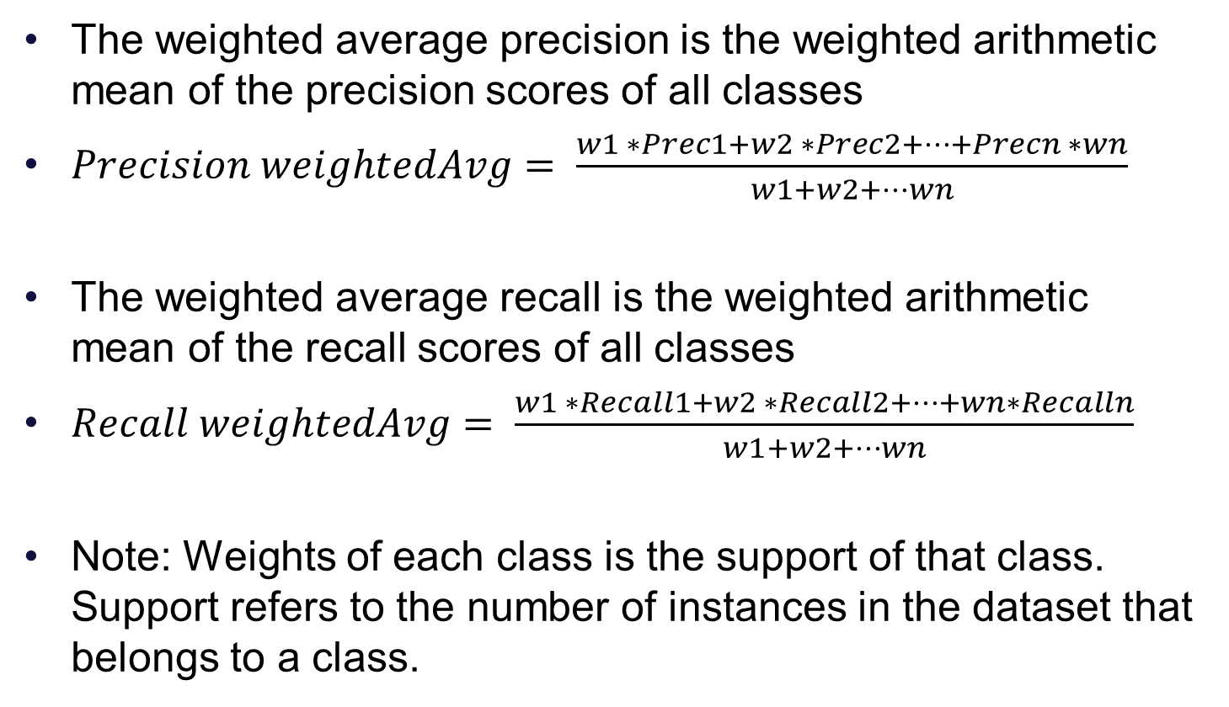
Weighted average precision & recall
The weighted average precision is the weighted arithmetic mean of the precision scores of all classes
$Precision weightedAvg= \frac{w1 ∗Prec1+w2 ∗Prec2+…+Precn ∗wn}{w1+w2+…wn}$
The weighted average recall is the weighted arithmetic mean of the recall scores of all classes
$Recall weightedAvg= \frac{w1 ∗Recall1+w2 ∗Recall2+…+wn∗Recalln}{w1+w2+…wn}$
Note: Weights of each class is the support of that class. Support refers to the number of instances in the dataset that belongs to a class.

Slide 24
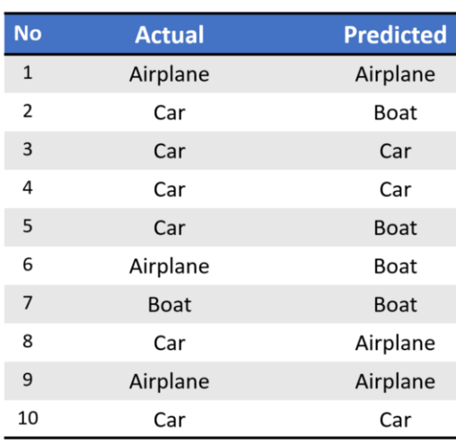
Example
Classes: Aeroplane, Car, Boat
Support: 3, 6, 1 respectively

Slide 25
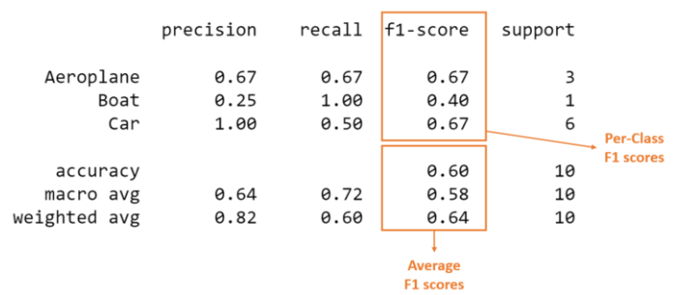
Classification Report

Slide 26
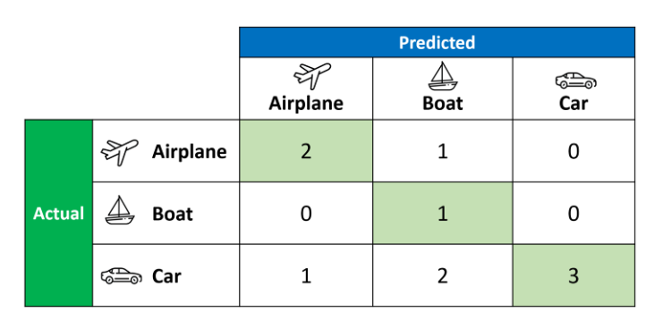
Confusion Matrix

Slide 27
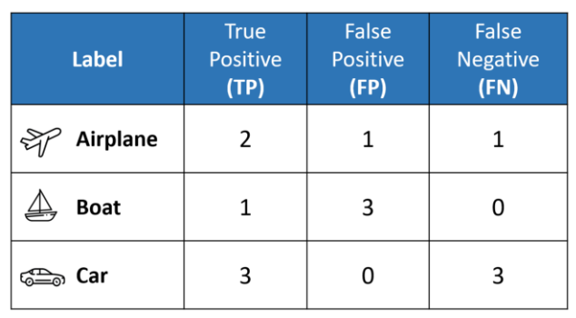
Calculated TP, FP, and FN values from confusion matrix

Slide 28
classification_report of sklearn
macro-average: It is calculated as arithmetic mean of individual classes’ metric values
Weighted average: It is calculated as the weighted arithmetic mean of individual classes’ metric values. The weights are nothing but the support count of each class
micro-average: It is calculated from the individual classes’ true positives (TPs), true negatives (TNs), false positives (FPs), and false negatives (FNs) of the model

Slide 29
classification_report of sklearn
micro-averaging provides equal weight for each instance or sample
macro-averaging treats all classes equally
weighted macro-averaging score is used in case of class imbalances

Slide 30
Classification Techniques
Decision Tree based Methods
Rule-based Methods
Memory based reasoning
Neural Networks
Naïve Bayes and Bayesian Belief Networks
Support Vector Machines

Slide 31
Decision tree
Decision tree induction is the learning of decision trees from class-labeled training tuples
A decision tree is a tree structure (nodes and edges)
The topmost node in a tree is the root node
Internal node (non-leaf node) including root holds an attribute
Denotes a test on an attribute
Separates records that have different characteristics
Branch (edge) represents an outcome of the test
Leaf node (or terminal node) holds a class label

Slide 32
Decision Tree
categorical
categorical
continuous
class
Splitting Attributes
Home Owner
Yes
No
NO
MarSt
Single, Divorced
Income
NO
< 80K
> 80K
NO
YES

Slide 33
Apply Model to Test Data
Start from the root of tree
Test Data
Home Owner
Yes
No
NO
Marital Status
Single, Divorced
Married
Income
NO
< 80K
> 80K
NO
YES

Slide 34
Apply Model to Test Data
Test Data
Home Owner
Yes
No
NO
Marital Status
Single, Divorced
Married
Income
NO
< 80K
> 80K
NO
YES

Slide 35
Apply Model to Test Data
Test Data
Home Owner
Yes
No
NO
Marital Status
Single, Divorced
Married
Income
NO
< 80K
> 80K
NO
YES

Slide 36
Apply Model to Test Data
Test Data
Home Owner
Yes
No
NO
Marital Status
Single, Divorced
Married
Income
NO
< 80K
> 80K
NO
YES

Slide 37
Apply Model to Test Data
Test Data
Home Owner
Yes
No
NO
Marital Status
Single, Divorced
Married
Income
NO
< 80K
> 80K
NO
YES

Slide 38
Apply Model to Test Data
Test Data
Home Owner
Yes
No
NO
Marital Status
Single, Divorced
Married
Assign Defaulted to “No”
Income
NO
< 80K
> 80K
NO
YES

Slide 39
Another Example of Decision Tree
categorical
categorical
continuous
class
Single, Divorced
MarSt
Married
NO
Home Owner
Yes
No
NO
Income
< 80K
> 80K
NO
YES
There could be more than one tree that fits the same data!

Slide 40
Decision Tree Classification Task
Decision Tree

Slide 41
Decision Tree Induction
Many Algorithms:
Hunt’s Algorithm (one of the earliest)
CART (Classification and Regression Trees)
ID3 (Iterative Dichotomiser), C4.5 (a successor of ID3)
SLIQ, SPRINT
Greedy, Recursive
Build tree in top-down manner
Starts with a training set of tuples and their associated class labels
The training set is recursively partitioned into smaller subsets as the tree is being built

Slide 42
Hunt’s Algorithm
Let
D_{t} be the set of training records
node t
y = {y1, y2, . . . , yc} be the class labels
Step1: If D_{t} contains records that belong to the same class y_{t}, then t is a leaf node labeled as y_{t}
D_{t}
?

Slide 43
Hunt’s Algorithm
Step 2: If D_{t} contains records that belong to more than one class
Use an attribute test (splitting criterion) is chosen to split the records into smaller subsets
Label the node t with best attribute
A branch is grown from node t for each of the outcomes of the splitting attribute and a child node is created
The tuples in Dt are partitioned accordingly
Recursively apply the procedure to each child node
D_{t}
?

Slide 44
Hunt’s Algorithm : Additional cases
If D_{t} is an empty set
Then t is a leaf node labeled by the majority class, y_{d} of training records associated with the parent
If all the records associated with D_{t} have identical attribute values (except for the class label)
The node is declared a leaf node with the same class label as the majority class of training records associated with this node
D_{t}
?

Slide 45
Hunt’s Algorithm

Slide 46
Design Issues of Decision Tree Induction
How should the training records be split?
Test condition and outcomes for different attribute types
An objective measure for evaluating the goodness of each test condition

Slide 47
Test conditions on Attributes & outcomes
Depends on attribute types
Nominal
Ordinal
Continuous
Number of ways to split
2-way split (or) Binary
Multi-way split

Slide 48
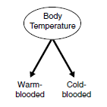
Binary attributes
The test condition for a binary attribute generates two potential outcomes

Slide 49
Nominal Attributes
Can be Multi-way split or Binary split
Multi-way split: Use as many partitions as distinct values

Slide 50
Nominal Attributes
Binary split: Divide attribute into 2 subsets
Need to find optimal partitioning

Slide 51
Ordinal Attributes
Can be Multi-way split or Binary split
Multi-way split:
Use as many partitions as distinct values

Slide 52
Ordinal Attributes
Binary split:
Group values into 2 subsets
Grouping should preserve order property among attribute values
Need to find optimal partitioning
This grouping violates order property

Slide 53
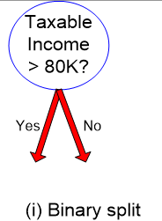
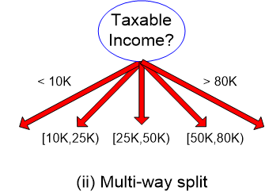
Continuous Attributes
Can be binary or multi-way
Binary split:
Choose a value v and perform a comparison test (A < v) or (A ≥ v) with binary outcomes
Multi-way split:
Use a range of values for splitting

Slide 54
Splitting Based on Continuous Attributes
Different ways of handling
Discretization to form an ordinal categorical attribute
ranges can be found by equal interval bucketing, equal frequency bucketing (percentiles), or clustering.
Binary : (A < v) or (A ≥ v)
consider all possible splits and finds the best split
can be more compute intensive

Slide 55
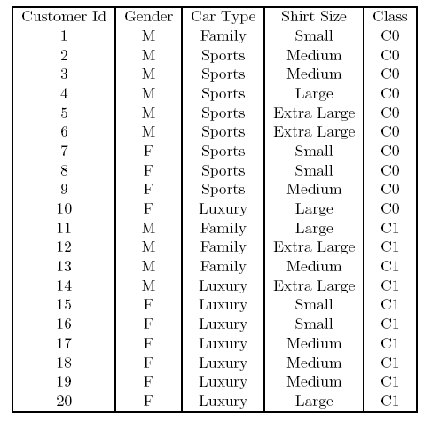
Measures of Node Impurity
Class distribution before Splitting: 10 records of class 0
10 records of class 1

Slide 56
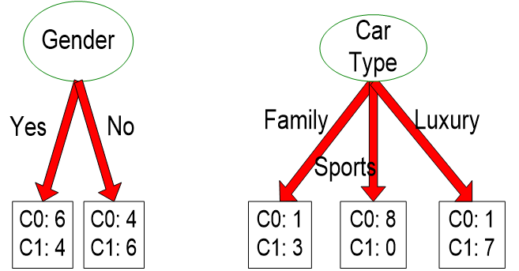
Measures of Node Impurity
Splitting according to gender and car type attributes

Slide 57
Measures of Node Impurity
Nodes with pure class distribution are preferred as their impurity is low
Node with uniform class distribution
High degree of impurity
Node with skewed class distribution
Low degree of impurity

Slide 58
Measures of Node Impurity
Gini Index
Entropy
0 log₂ 0 = 0 in entropy calculations
Classification error
i is the number of classes
p(i|t) denote the fraction of records belonging to class i at a given node t
t can be omitted and can be referred as p_{i}

Slide 59
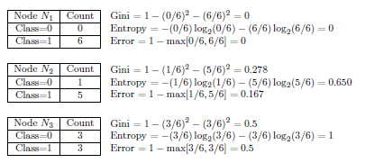
Measures of Node Impurity

Slide 60
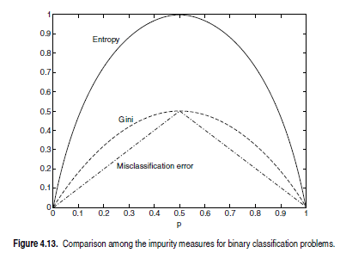
Measures of Node Impurity

Slide 61
How to determine the best attribute for splitting
To determine how well a test condition on an attribute performs
Compute degree of impurity of the parent node (before splitting)
Compute degree of impurity of the child nodes (after splitting)
Compute weighted average impurity of the split
Compute the gain Δ
The larger the gain, the better the test condition

Slide 62

How to determine the best attribute for splitting
The gain, Δ, is a criterion that can be used to determine the goodness of a split
I(·) is the impurity measure of a given node
N is the total number of records at the parent node
k is the number of partitions
N(v_{j}) is the number of records associated with the partition v_{j}
Since I(parent) is the same for all test conditions, maximizing the gain is equivalent to minimizing the weighted average impurity measures of the child nodes
When entropy is used as the impurity measure, in the above equation, then the difference in entropy is known as the information gain, Δ_{info}

Slide 63
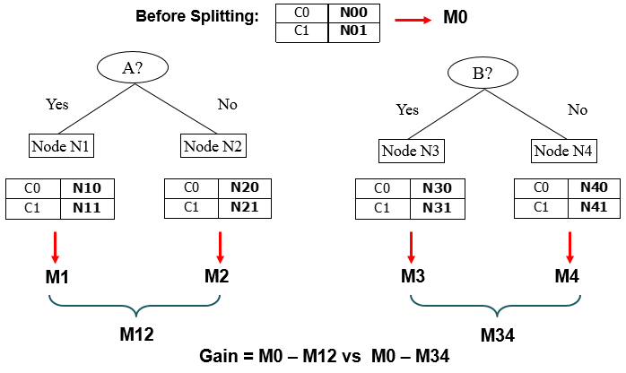
How to Find the Best Split

Slide 64
Splitting of Binary Attributes
A | B | Class
Y | Y | C0
Y | N | C0
Y | N | C0
Y | N | C0
Y | Y | C1
Y | Y | C1
Y | Y | C1
N | N | C0
N | N | C0
N | Y | C1
N | N | C1
N | N | C1
Compute the Gini
At the parent
When A is used as the splitting attribute
When B is used as the splitting attribute
Compute the Classification error
At the parent
When A is used as the splitting attribute
When B is used as the splitting attribute

Slide 65



Splitting of Binary Attributes
A | B | Class
Y | Y | C0
Y | N | C0
Y | N | C0
Y | N | C0
Y | Y | C1
Y | Y | C1
Y | Y | C1
N | N | C0
N | N | C0
N | Y | C1
N | N | C1
N | N | C1
Attribute A
Attribute B

Slide 66
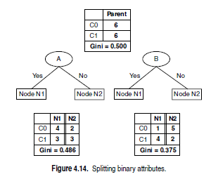
Splitting of Binary Attributes
1. Compute Gini at parent
2. Compute Gini at each child node
3. Compute Gini of split (a.k.a weighted average impurity)
4. Compute Gain
Impurity at parent - weighted average impurity
5. Choose the attribute with highest gain

Slide 67
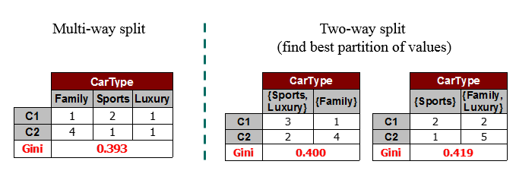
Splitting of Categorical Attributes
For each distinct value, gather counts for each class in the dataset
Use the count matrix to make decisions

Slide 68
Splitting of Continuous Attributes
Use Binary Decisions based on one value
Several Choices for the splitting value
Number of possible splitting values = Number of distinct values
Each splitting value has a count matrix associated with it
Class counts in each of the partitions, A < v and A ≥ v
Simple method to choose best v
For each v, scan the database to gather count matrix and compute its Gini index
Computationally Inefficient! Repetition of work.

Slide 69
Splitting of Continuous Attributes
For efficient computation: for each attribute,
Sort the attribute on values
Linearly scan these values, each time updating the count matrix and computing Gini index
Choose the split position that has the least gini index
Sorted Values
Split Positions

Slide 70
Stopping Criteria for Tree Induction
Stop expanding a node when all the records belong to the same class
Stop expanding a node when all the records have similar attribute values
Stop expanding a node when the number of records has fallen below some minimum threshold value

Slide 71
Tree pruning
After building the decision tree, a tree-pruning step can be performed to reduce the size of the decision tree
Decision trees that are too large are susceptible to a phenomenon known as overfitting
Pruning helps by trimming the branches of the initial tree in a way that improves the generalization capability of the decision tree

Slide 72
Decision Tree Induction Characteristics
Non-parametric approach
Finding an optimal decision tree is an NP-complete problem
NP-complete problem: class of computational problems for which no efficient algorithm has been found
Heuristic-based approach is used to guide the search
A heuristic technique, is any approach to problem solving that employs a method that is not guaranteed to be optimal, but is nevertheless sufficient for reaching an approximate solution
Computationally inexpensive to construct

Slide 73
Decision Tree Induction Characteristics
Extremely fast at classifying unknown records once a decision tree has been built
worst-case complexity of O(w), where w is the maximum depth of the tree
Easy to interpret for small-sized trees
Accuracy is comparable to other classification techniques for many simple data sets
Decision tree algorithms are quite robust to the presence of noise when methods to avoid overfitting are employed
Redundant attributes does not affect the accuracy of decision trees
Irrelevant attributes results in a decision tree that is larger
Feature selection techniques can help to improve the accuracy of decision trees by eliminating the irrelevant attributes during preprocessing

Slide 74
Decision Tree Induction Characteristics
Data fragmentation problem
Most decision tree algorithms employ a top-down, recursive partitioning approach
The number of records becomes smaller as we traverse down the tree
At the leaf nodes, the number of records may be too small to make a statistically significant decision about the class representation of the nodes
Solution
Disallow further splitting when the number of records falls below a certain threshold.

Slide 75
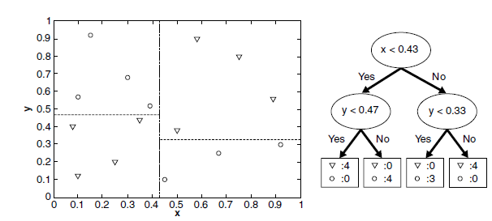
Decision Tree Induction Characteristics
If we use single attribute at a time for the test conditions, the tree-growing procedure can be viewed as the process of partitioning the attribute space into disjoint regions until each region contains records of the same class

Slide 76
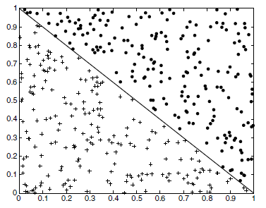
Decision Tree Induction Characteristics
The border between two neighboring regions of different classes is known as a decision boundary
Since the test condition involves only a single attribute, the decision boundaries are rectilinear; i.e., parallel to the coordinate axes
This limits the expressiveness of the decision tree representation for modeling complex relationships among continuous attributes
Sample dataset where a rectilinear boundary
will not effectively partition the records

Slide 77
Decision Tree Induction Characteristics
An oblique decision tree can be used to overcome this limitation because it allows test conditions that involve more than one attribute
Although such techniques are more expressive and can produce more compact trees, finding the optimal test condition for a given node can be computationally expensive

Slide 78
Decision Tree Induction Characteristics
Studies have shown that the choice of impurity measure has little effect on the performance of decision tree induction algorithms

Slide 79
Model Overfitting
Errors committed by a classification model
Training errors / resubstitution error / apparent error
Generalization errors
Training errors (apparent errors)
Errors (misclassification) committed on the training set
Generalization error
The error (misclassification) of the model on previously unseen records
Good classification model
Not only fit the training data well, it must also accurately classify records it has never seen before (i.e.,) low training and generalization error

Slide 80
Model Overfitting
Model overfitting
Model performs well on training data (low training error)
Model does not generalizes well for unseen data (high generalization error)

Slide 81
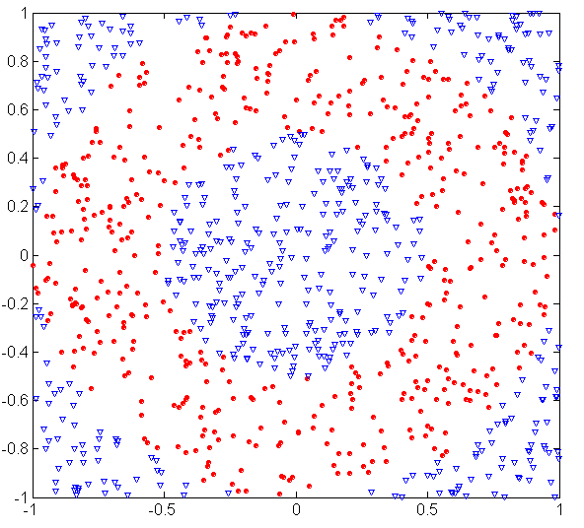
Example
1200 circular and 1800 triangular data points.
30% of the points are chosen for testing, while the remaining 70% are used for training
A decision tree classifier that uses the Gini index as impurity measure is then applied to the training set

Slide 82
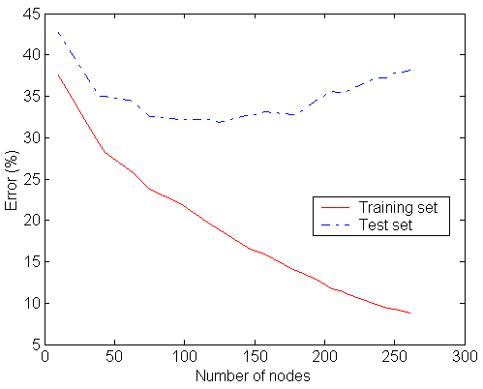
Training and test error rates
Underfitting
When the training and test error rates of the model are large
Underfitting occurs because the model is yet to learn the true structure of the data

Slide 83
Model Overfitting
The training error of a model can be reduced by increasing the model complexity
For example, the leaf nodes of the tree can be expanded until it perfectly fits the training data
Although the training error for such a complex tree is zero, the test error can be large because the tree may contain nodes that accidently fit some of the noise points in the training data

Slide 84
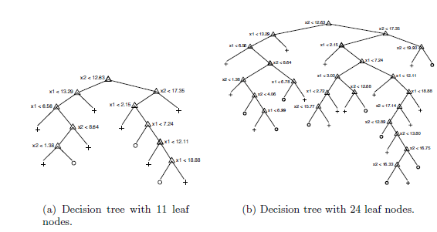
Model Overfitting
The tree that contains the smaller number of nodes has a higher training error rate, but a lower test error rate compared to the more complex tree

Slide 85
Overfitting causes
Noise
Insufficient examples

Slide 86
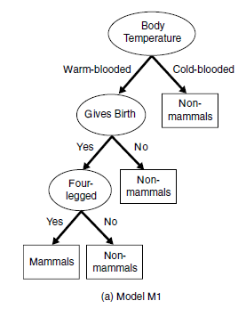
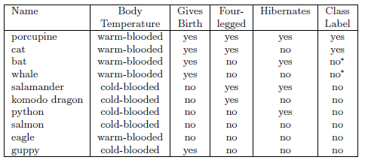
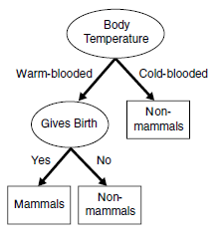
Training set for mammals classification & models M1, M2

Slide 87
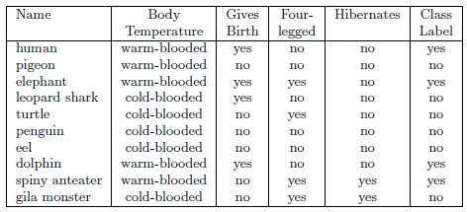
Test set for mammals classification & M1’s performance
Training error = zero
Test error = 30%
Humans and dolphins were misclassified

Slide 88
Test set for mammals classification & M2’s performance
Training error rate = 20%
Test error rate = 10%

Slide 89
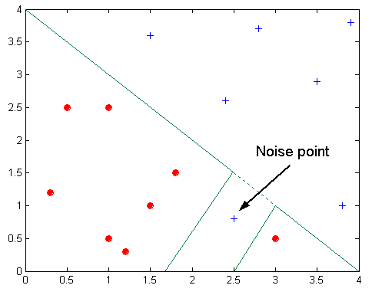
Overfitting due to Noise

Slide 90
Overfitting due to Insufficient Examples
Models that make their classification decisions based on a small number of training records are also susceptible to overfitting
Such models can be generated because of lack of representative samples in the training data and learning algorithms that continue to refine their models even when few training records are available

Slide 91
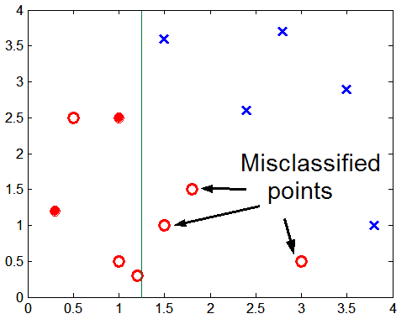
Overfitting due to Insufficient Examples
Lack of data points in the lower half of the diagram makes it difficult to predict correctly the class labels of that region
- Insufficient number of training records in the region causes the decision tree to predict the test examples using other training records that are irrelevant to the classification task

Slide 92
Handling Overfitting in Decision Tree Induction
Pre-pruning
Post-pruning

Slide 93
Prepruning (Early Stopping Rule)
The tree-growing algorithm is halted before generating a fully grown tree that perfectly fits the entire training data
Stopping condition must be used
Stop expanding a leaf node when the observed gain in impurity measure falls below a certain threshold
Advantage
Avoids generating overly complex subtrees that overfit the training data
Disadvantage
Difficult to choose the right threshold for early termination

Slide 94
Post-pruning
The decision tree is initially grown to its maximum size which is followed by a tree-pruning step
Trim the fully grown tree in a bottom-up fashion
Trimming replaces a subtree with a new leaf node whose class label is determined from the majority class of records associated with the subtree
Advantage
Give better results than prepruning because it makes pruning decisions based on a fully grown tree
Disadvantage
Additional computations needed to grow the full tree may be wasted when the subtree is pruned

Slide 95
Notes on Overfitting
Overfitting results in decision trees that are more complex than necessary
Training error no longer provides a good estimate of how well the tree will perform on previously unseen records
Need new ways for estimating errors

Slide 96
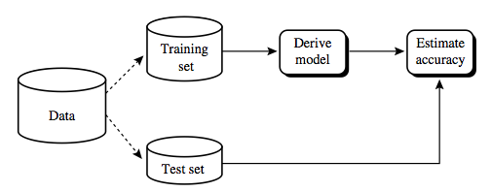
Evaluating the Performance of a Classifier
Classifiers are learned (trained) on a finite training data
A learned classifier has to be tested on a different test set experimentally
The performance of classifiers on test data shows the generalization capability

Slide 97
Evaluating the Performance of a Classifier
Methods
Hold out
Random subsampling
Cross validation
Boostrap

Slide 98
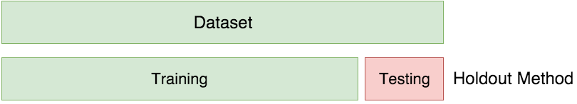
Hold out method
The data is randomly partitioned into two disjoint sets
Training set (2/3) for learning the classifier and Testing set (1/3) for classifier accuracy evaluation

Slide 99
Random Subsampling
The holdout method can be repeated several times to improve the estimation of a classifier’s performance
Let acc_{i} be the model accuracy during the i^{th} iteration
The overall accuracy is given by
Disadvantage
It has no control over the number of times each record is used for testing and training
Consequently, some records might be used for training more often than others

Slide 100
K-fold cross validation
Each record is used the same number of times for training and exactly once for testing
Partition dataset into k equal sized “folds”
Train on k-1 folds
Test on the remaining fold
In the extreme (n=k) this is known as “leave-one-out” cross validation

Slide 101
Cross-validation visualized
Available Labeled Data
Identify n partitions
Train
Train
Train
Train
Train
Test
Fold 1

Slide 102
Cross-validation visualized
Available Labeled Data
Identify n partitions
Test
Train
Train
Train
Train
Train
Fold 2

Slide 103
Cross-validation visualized
Available Labeled Data
Identify n partitions
Train
Test
Train
Train
Train
Train
Fold 3

Slide 104
Cross-validation visualized
Available Labeled Data
Identify n partitions
Train
Train
Test
Train
Train
Train
Fold 4

Slide 105
Cross-validation visualized
Available Labeled Data
Identify n partitions
Train
Train
Train
Test
Train
Train
Fold 5

Slide 106
Cross-validation visualized
Available Labeled Data
Identify n partitions
Train
Train
Train
Train
Test
Train
Fold 6
Calculate Average Performance

Slide 107
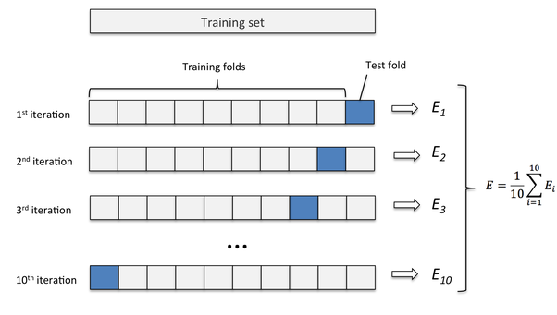
Leave-one-out
A special case of K-fold cross validation with K=n, where n is the total number of samples in the training set.
n experiments are performed using n−1 samples for training and the remaining sample for testing.

Slide 108
Bootstrap
The training records are sampled with replacement
A record already chosen for training is put back into the original pool of records so that it is equally likely to be redrawn
Records that are not included in the bootstrap sample become part of the test set
The model induced from the training set is then applied to the test set to obtain an estimate of the accuracy of the bootstrap sample
The sampling procedure is then repeated b times to generate b bootstrap samples

Slide 109
Thank you

